Slide 1
Online Portfolio
Isabelle Peskett

Slide 2
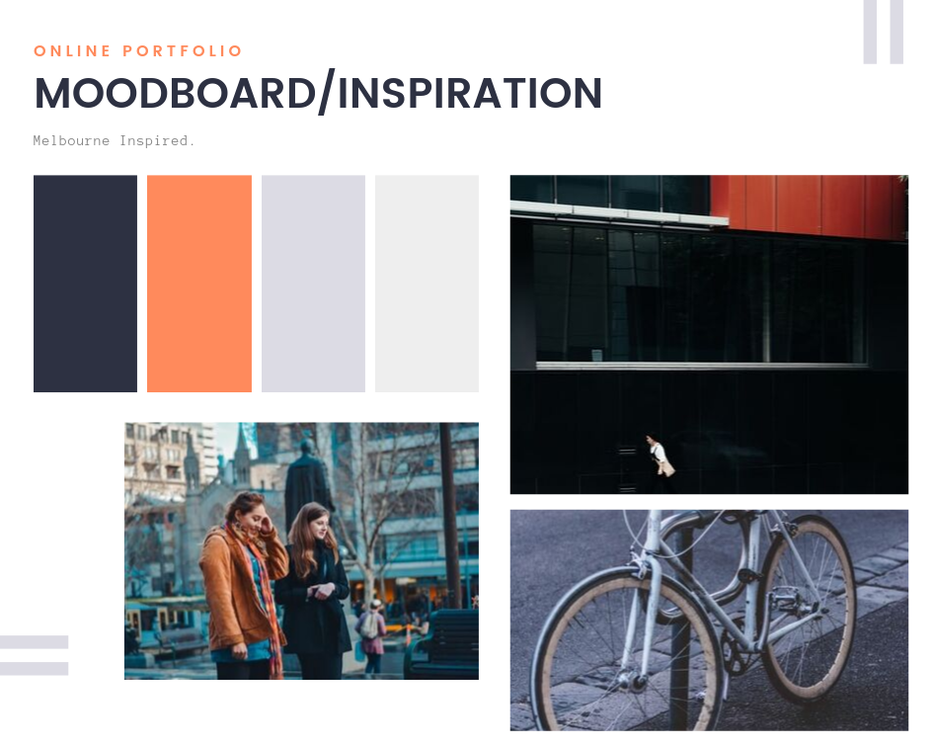

Slide 3
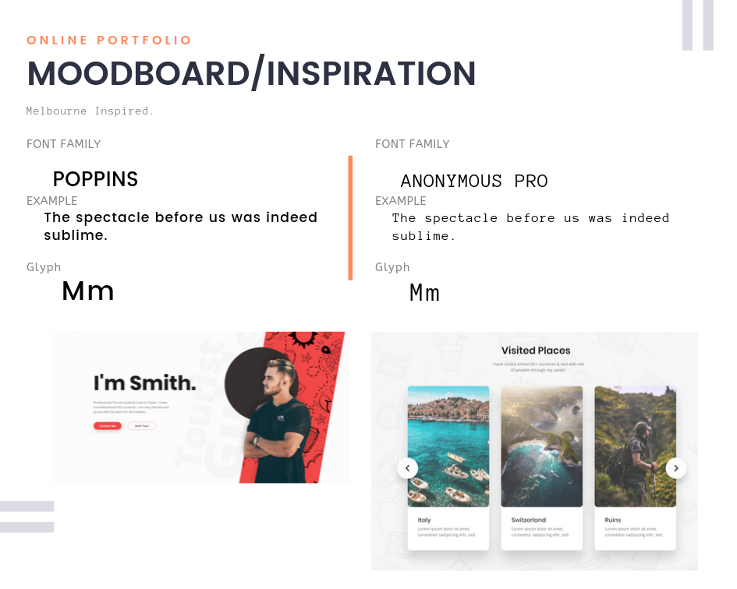

Slide 4
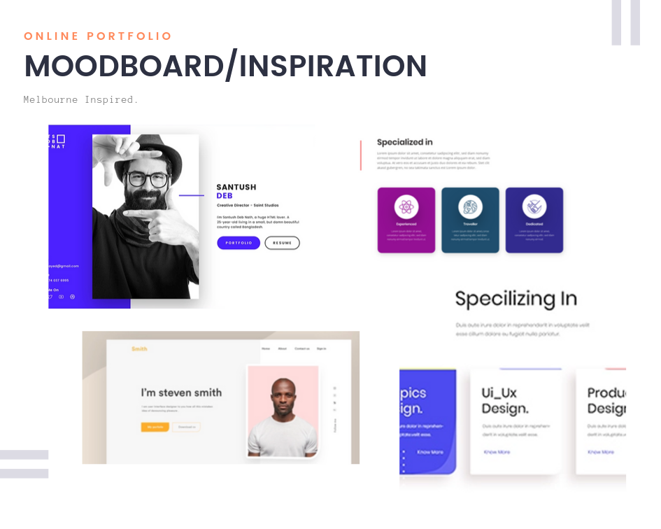

Slide 5
Sitemap.

Slide 6
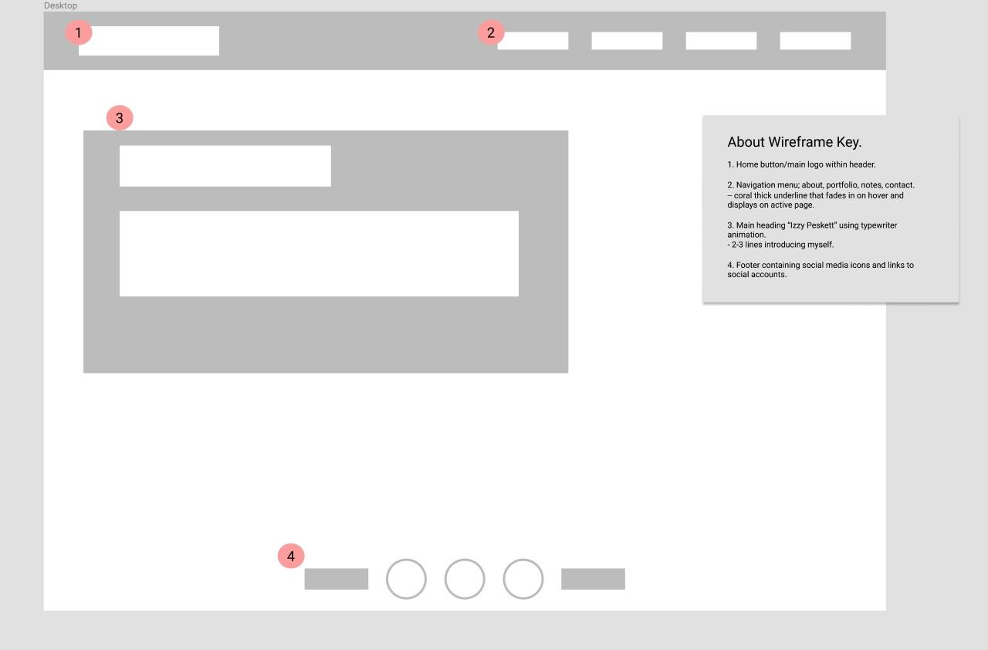
Wireframes

Slide 7
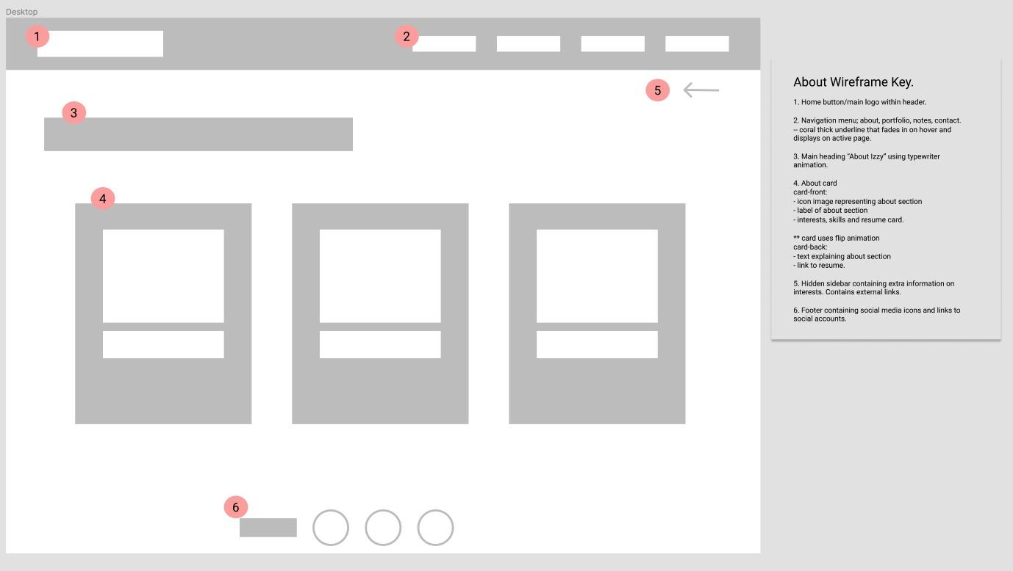
Wireframes

Slide 8
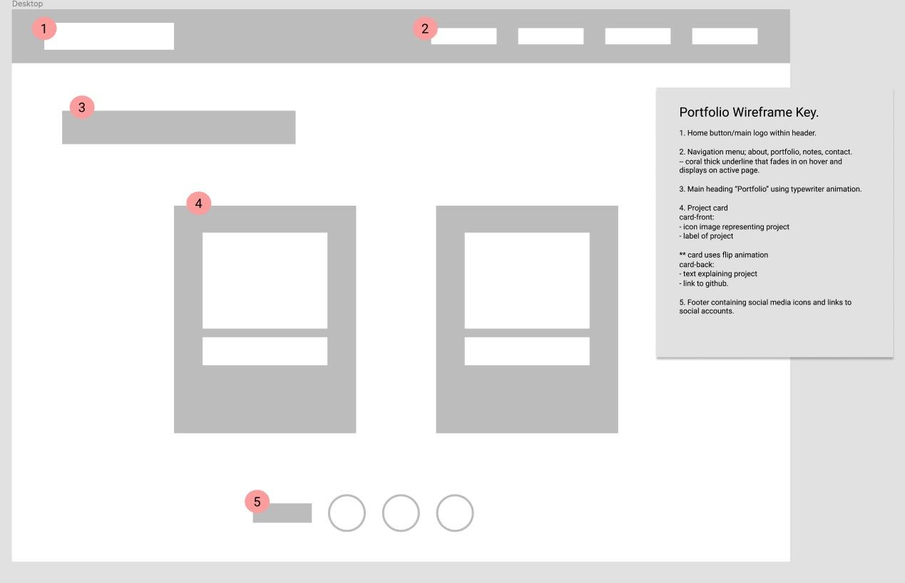
Wireframes

Slide 9
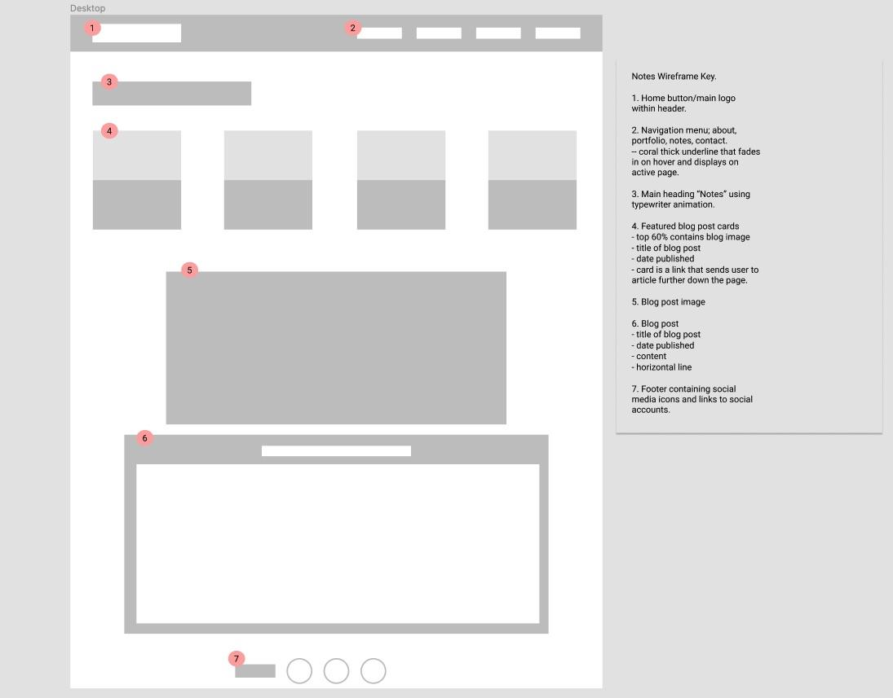
Wireframes

Slide 10
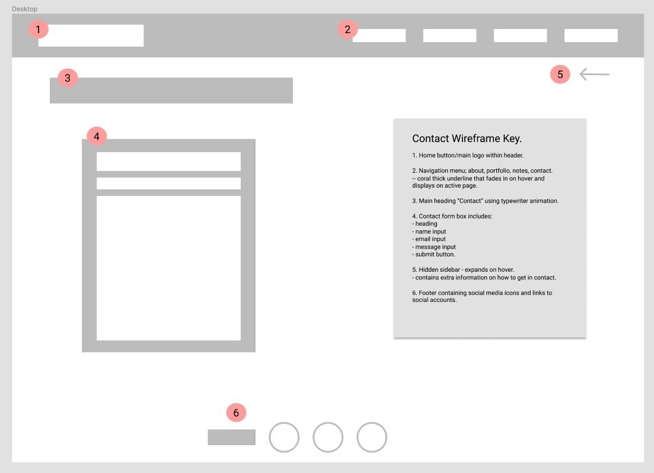
Wireframes

Slide 11
Process.
Moodboard
Sketch a few wireframes
Figma 1-2 wireframes
Start coding
CSS animation
CSS animation
CSS animation
Test deploy
Responsiveness
Change design
Responsiveness
Change design
CSS animation
Sitemap
Documentation
SRI/Deploy
Moodboard
Sketch wireframes
Figma wireframes
Sitemap
Skeleton html
Basic CSS
Detailed html
Detailed CSS
SRI/Deploy
Documentation

Slide 12
Features.
Minimal design + layout
Visibly easy for the user
Simple but effective typography and colour scheme
Animations allow many interaction points for the user
Conveys the type of company I would like to work for.
CSS grid + flex-box
Media queries
CSS animations
Google fonts + font awesome

Slide 13
Overall.
Challenges:
Responsiveness
Time management
Getting caught up in the design.
Enjoyed:
Creativity
Seeing your website come together
The ability to manipulate and create what you envisioned.

